Slide 1

Meeting Etiquette
Please be on Mute all the time.
Turn off Video, So that we can save bandwidth.
There is separate Q&A Section in End Please use that, Add questions in Google Form.
Break at 12PM for 15 min.
Mute your microphone
To help keep background noise to a minimum, make sure you mute your microphone when you are not speaking.
Be mindful of background noise
Avoid multitasking
All links and Slides will be shared.

Slide 2

Agenda
Rest Assured Revision.
Automating Web Application with Selenium.

Slide 3
REST Assured Concepts
Testing APIs using restassured(get,post,put,delete) given().(set your specs here).body(set your payload here) when().post/get/delete/put(api endpoint here) then().assertthat().(verify your api status code, time, json data and json schema here)
Oauth in restassured is supported with auth() method- basic-given().auth().basic(userName, password)
oauth1-given().auth().oauth(consumerKey, consumerSecret, accessToken, secretToken)
oauth2-given().auth().oauth2(accessToken)

Slide 4
REST Assured Concepts
Common request and response specification can be set in restassured using spec builders, example- protected RequestSpecification loginSpec = new RequestSpecBuilder()
.setBaseUri(DataUtils.getTestData("Config", "baseUrl", "Value")).setContentType("application/json").build()
.log().all();
json field data can be extracted in restassured using jsonpath class, example- public static <T> T getDataFromJsonPath(Response response, String jsonPath) {
return response.jsonPath().get(jsonPath);
}

Slide 5
REST Assured Concepts
Hamcrest is used in restassured to provide builtin assertions, example-
given().spec(userSpec).formParam("status", "completed").when().get(APIEndpoints.dashboardAPI).then()
.assertThat().statusCode(200).and().body("build_card_count.completed", equalTo(1)).and()
.body(matchesJsonSchema(DataUtils.getTestData("Schema", "login", "Value"))).and()
.time(lessThan(5L), TimeUnit.SECONDS);

Slide 6
REST Assured Concepts
Serialization and Deserialization between pojo(plain old java object) and json string is done using GSON. Examples-
From json to pojo class object-LoginRequest loginRequest = gson.fromJson(DataUtils.getTestData("Payloads", "login", "Value"),
LoginRequest.class);

Slide 7
REST Assured Concepts
From json to map- LinkedTreeMap<String, Object> jsonMap = new LinkedTreeMap<String, Object>();
jsonMap = gson.fromJson(jsonString, jsonMap.getClass());
From response json to pojo example- DashboardResponse dashboardResponse = gson.fromJson(given().spec(userSpec).formParam("status", "completed")
.when().get(APIEndpoints.dashboardAPI).getBody().asString(), DashboardResponse.class);

Slide 8
Selenium Introduction.

Slide 9

Selenium Introduction.

Slide 10
Why We need Selenium?
Selenium is Free and Open Source.
Selenium helps you to Automate the Web Browsers.
Selenium Suite Contains
Selenium IDE
Selenium Grid
Selenium 4(Webdriver)
Selenium Grid Solves the problem of Parallel Execution.
Manual Testing (Regression) is Boring.
Selenium Supports Multiple Browsers, OS and Programming Language.

Slide 11
When We don’t need Selenium?
Selenium can only automate the Web Application.
You can’ automate the Mobile Application with Selenium.
No Support for the Desktop Applications.
No Support for the Reporting feature.
Selenium has a hard time handling dynamic elements.
Selenium doesn’t provide any support for the Test Management.
Video Testing, Audio Testing, Captcha, Barcode, File Download, Upload Support.
You have a add third party libraries to add features like email, reporting extra.

Slide 12
What is Selenium?
Selenium is actually is suite
Selenium Webdriver ( Selenium 4)
Selenium IDE
Selenium Grid.

Slide 13
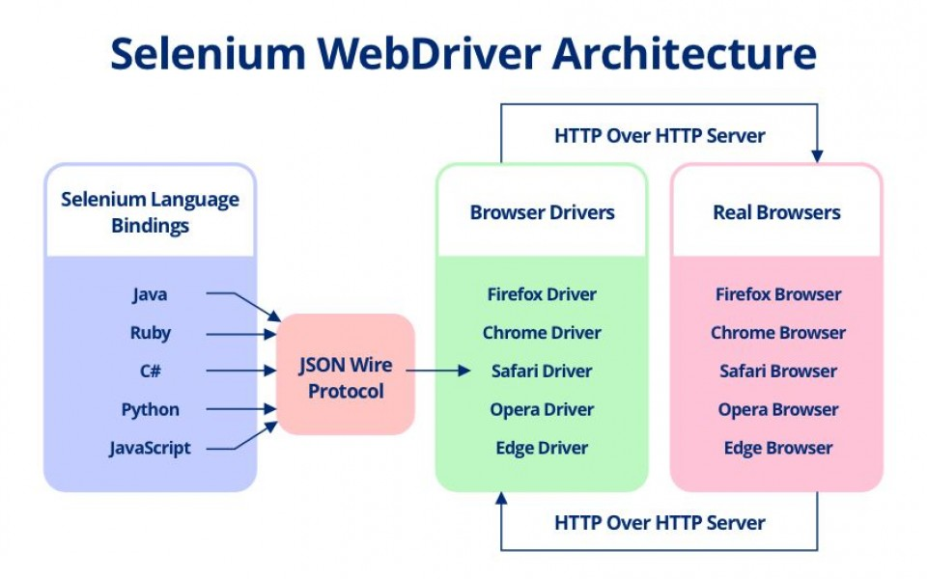
Selenium WebDriver
Web Framework that helps you automation Web Application, Cross browser Test extra.
In Nutshell, It’s a collection open source APIs that helps to automate browsers.

Slide 14
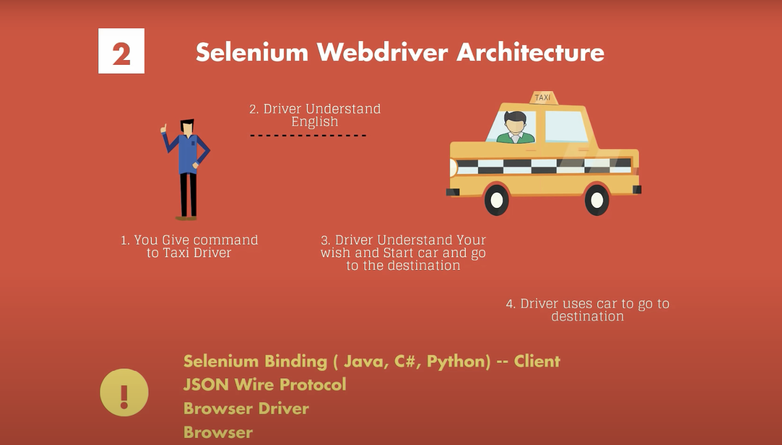
Selenium Webdriver Arch

Slide 15
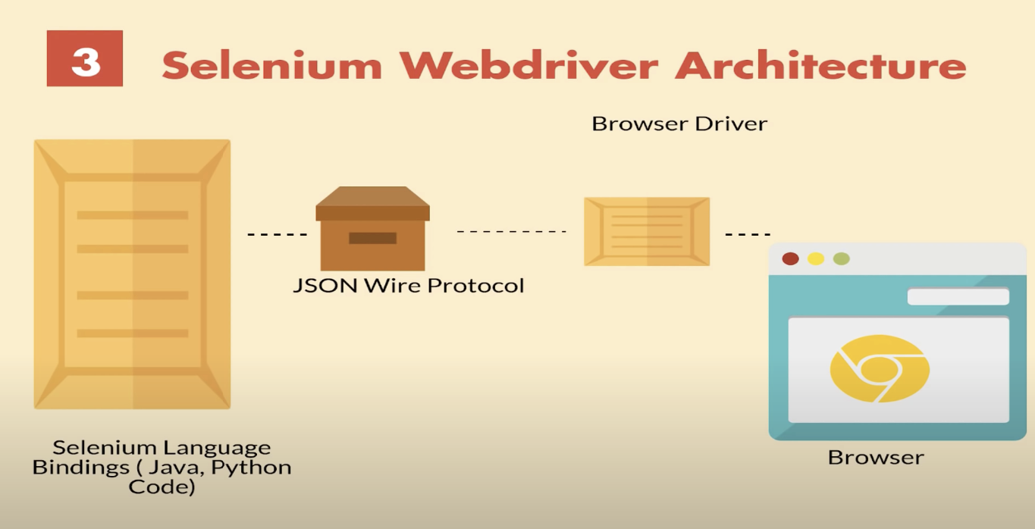
Selenium Webdriver Arch

Slide 16
How Selenium Works?
Download the Selenium Jar
Make sure you Webdrivers are in Path Variables.
Run the Jar
java -jar selenium-server-4.0.0-alpha-6.jar --ext example.jar:dir standalone --port 4444
Play with the APIs
Download the Collection
https://sdet.live/2CcR

Slide 17
Selenium 4 Supports W3 Protocol
Browser drivers will interact with Selenium WebDriver in W3C standard protocol

Slide 18
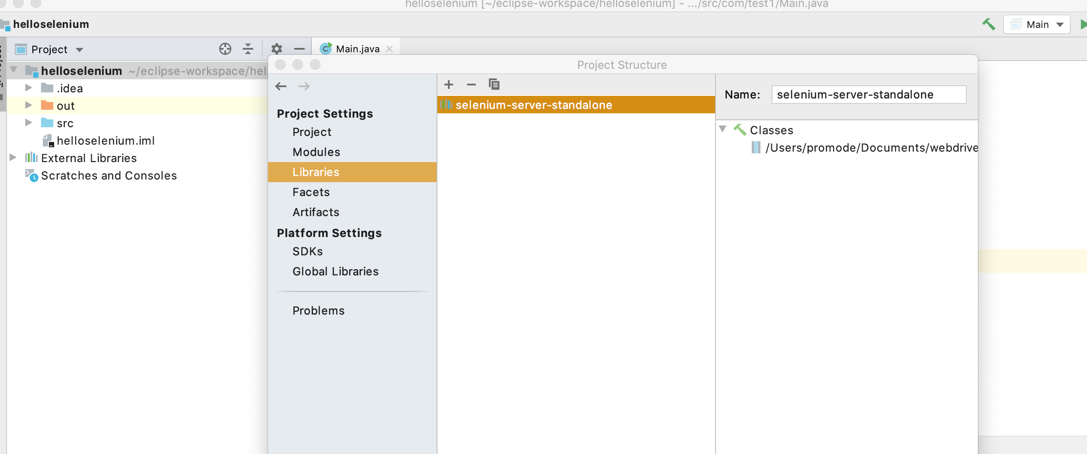
Selenium Standalone Server
Download the Selenium Jar
Make sure you Webdrivers are in Path Variables.
Run the Jar
java -jar selenium-server-standalone.jar

Slide 19
Run a Hello World
Download the Selenium Jar
Create a Command line Project intellij
Add to Project

Slide 20
Selenium IDE
Open source record and playback test automation for the web
Selenide Language
Installation
Launch the IDE
Recording test
suite
test
Command-line Runner
npm install -g selenium-side-runner
npm install -g chromedriver
npm install -g geckodriver
Control Flow
Code Export

Slide 21
Selenium Grid
Smart proxy server that makes it easy to run tests in parallel on multiple machines.
Major components of Selenium Grid.
Hub is a server that accepts the access requests from the WebDriver client, routing the JSON test commands to the remote drives on nodes. It takes instructions from the client and executes them remotely on the various nodes in parallel
Node is a remote device that consists of a native OS and a remote WebDriver. It receives requests from the hub in the form of JSON test commands and executes them using WebDriver

Slide 22
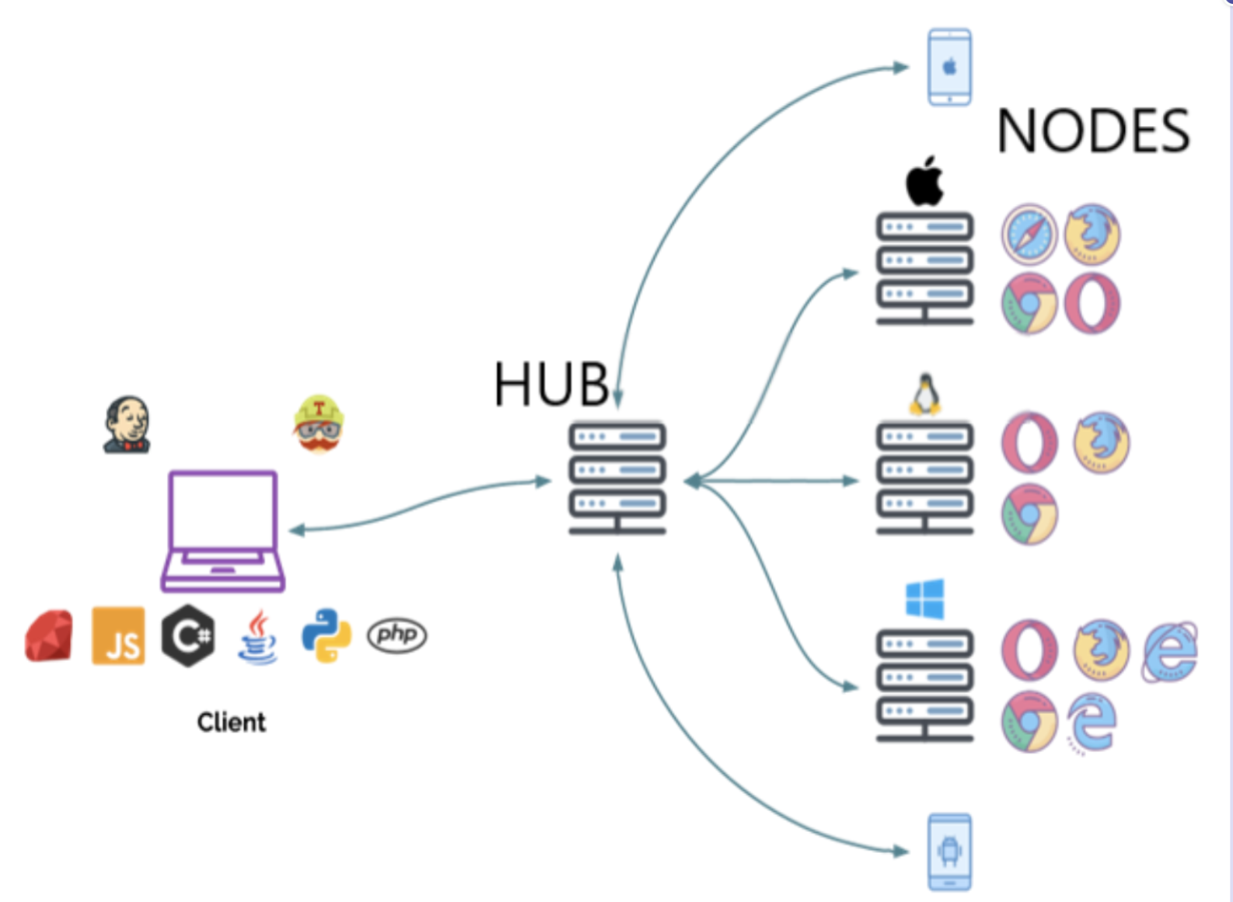
Selenium Grid

Slide 23
When to use Selenium Grid
Multiple browsers and their versions.
Reduce the time that a test suite takes to complete a test.
Cross Browser Testing.

Slide 24
How to Start Selenium Grid
java -jar selenium-server-standalone-<version>.jar -role hub
java -jar selenium-server-standalone-<version>.jar -role node -hub https://localhost:4444/grid/register
DesiredCapabilities capability = DesiredCapabilities.firefox();
WebDriver driver = new RemoteWebDriver(new URL("https://localhost:4444/wd/hub"), capability);

Slide 25
How to Start Selenium Grid
capability.setBrowserName();
capability.setPlatform();
capability.setVersion()
capability.setCapability(,);

Slide 26
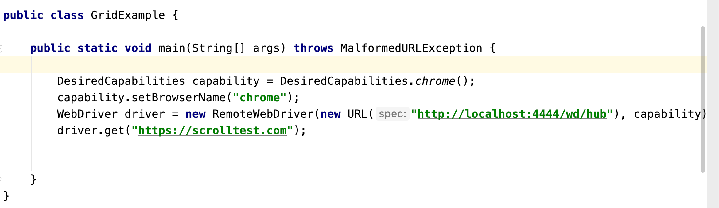
How to Start Selenium Grid

Slide 27
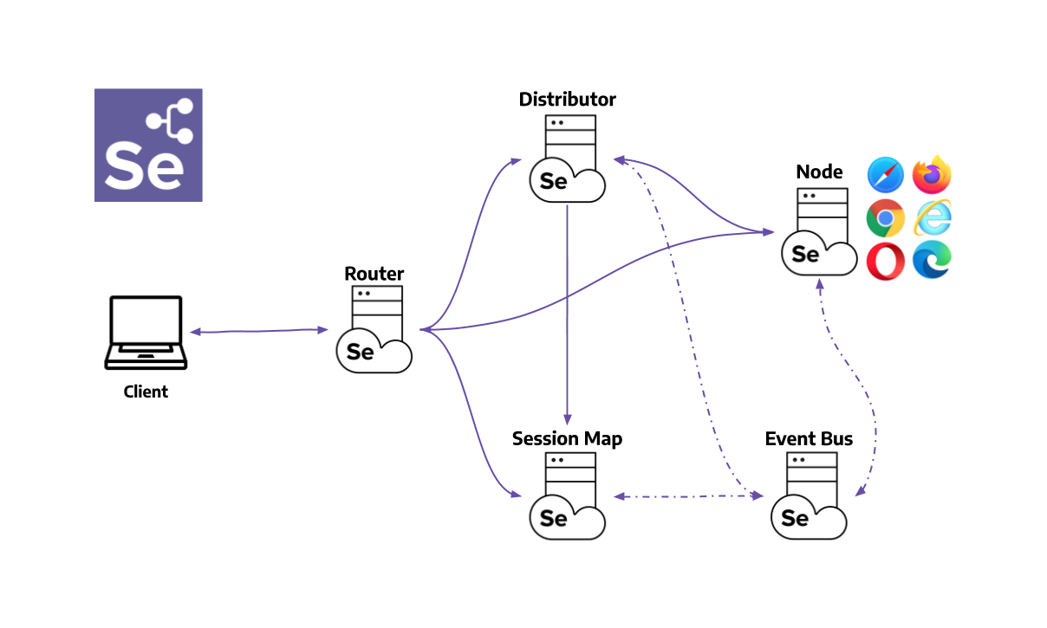
SeleniuM Grid 4

Slide 28
Grid 4 Components
Router - Takes care of forwarding the request to the correct component.
Distributor - Its main role is to receive a new session request and find a suitable Node where the session can be created.
Node - Each Node takes care of managing the slots for the available browsers of the machine where it is running.
Session Map - Keeps the information of the session id and the Node where the session is running
Event Bus - Event Bus serves as a communication path between the Nodes
The Grid does most of its internal communication through messages, avoiding expensive HTTP calls

Slide 29
Different Grid Types
Standalone Mode
Classical Grid (Hub and Node like earlier versions)
Fully Distributed (Router, Distributor, Session, and Node)

Slide 30
Run Grid 4
Running in Standalone Mode ( vs Distributed Mode)
java -jar selenium-server-4.0.0-alpha-6.jar standalone
Start the Hub:
java -jar selenium-server-4.0.0-alpha-6.jar hub
Register a Node:
java -jar selenium-server-4.0.0-alpha-6.jar node --detect-drivers
https://www.selenium.dev/documentation/en/grid/grid_4/setting_up_your_own_grid/

Slide 31
Run Selenium on Docker
https://github.com/SeleniumHQ/docker-selenium
docker run -d -p 4444:4444 -v /dev/shm:/dev/shm selenium/standalone-chrome:4.0.0-alpha-7-prerelease-20201009

Slide 32
Selenium First Program.
App.vwo.com
Verify the Title, Url

Slide 33
Selenium First Program.
App.vwo.com
Verify the Title, Url

Slide 34
QnA

